Slide 1


Management Information Systems: Managing the Digital Firm
Sixteenth Edition
Chapter 11
Managing Knowledge and Artificial Intelligence

Slide 2
Learning Objectives
What is the role of knowledge management systems in business?
What types of systems are used for enterprise-wide knowledge management, and how do they provide value for businesses?
What are the major types of knowledge work systems, and how do they provide value for firms?
What are the business benefits of using intelligent techniques for knowledge management?

Slide 3
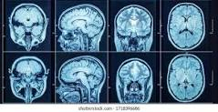
AI Can Read A Cardiac MRI In 4 Seconds: Do We Still Need Human Input?
It generally takes about 13 minutes for a trained physician (cardiologist) to interpret a cardiac MRI. But with the advent of artificial intelligence (AI) and machine learning algorithms, a scan can be analyzed with similar accuracy in approximately four seconds–nearly 186 times faster!
AI techniques such as pattern recognition were able to increase mammogram accuracy so that the computer system produced more accurate mammogram readings than human radiologists.

Slide 4
What is the Role of Knowledge Management Systems in Business?
Knowledge management systems among fastest growing areas of software investment
Information economy
37 percent U.S. labor force: knowledge and information workers
55 percent U.S. GDP from knowledge and information sectors
Substantial part of a firm’s stock market value is related to intangible assets: knowledge, brands, reputations, and unique business processes
Well-executed knowledge-based projects can produce extraordinary ROI

Slide 5
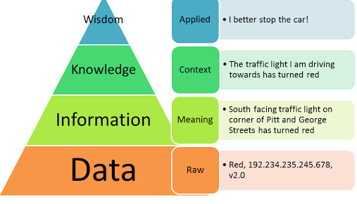
Data, Information, Knowledge and Wisdom
Data is flow of events or transactions captured by an organization’s systems that are useful for transacting but little else.
To turn data into useful information, a firm must expend resources to organize data into categories of understanding, such as monthly, daily, regional, or store-based reports of total sales.
To transform information into knowledge, a firm must expend additional resources to discover patterns, rules, and contexts where the knowledge works.
Finally, wisdom is thought to be the collective and individual experience of applying knowledge to the solution of problems. Wisdom involves where, when, and how to apply knowledge.

Slide 6
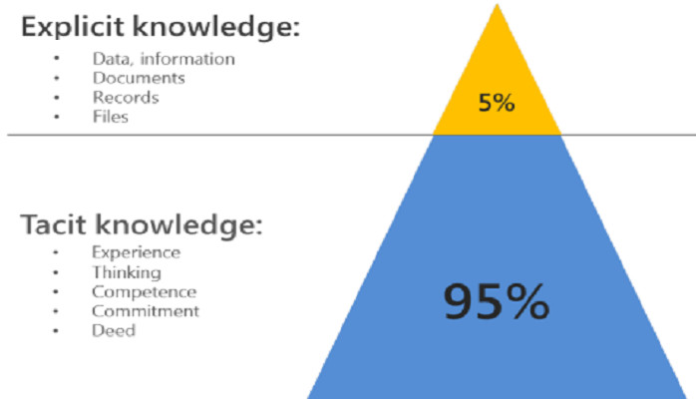
Explicit and Tacit Knowledge
Knowledge residing in the minds of employees that has not been documented is called tacit knowledge, whereas knowledge that has been documented is called explicit knowledge. Knowledge can reside in email, voice mail, graphics, and unstructured documents as well as structured documents.

Slide 7
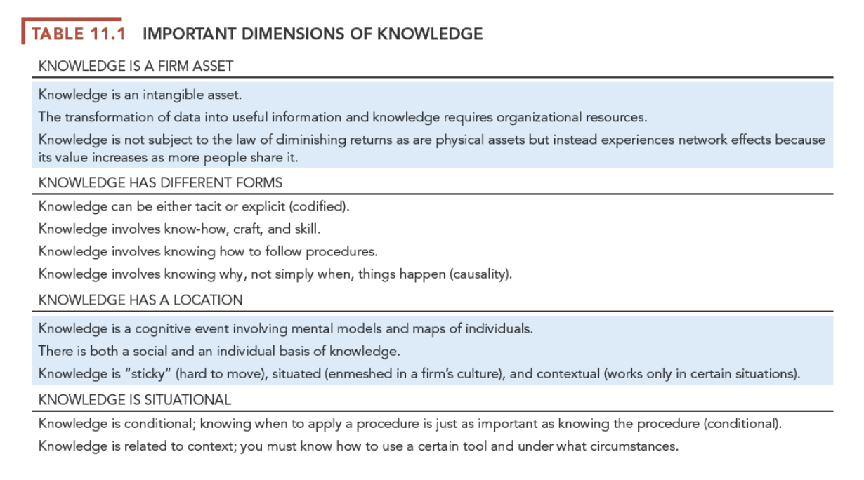

Slide 8
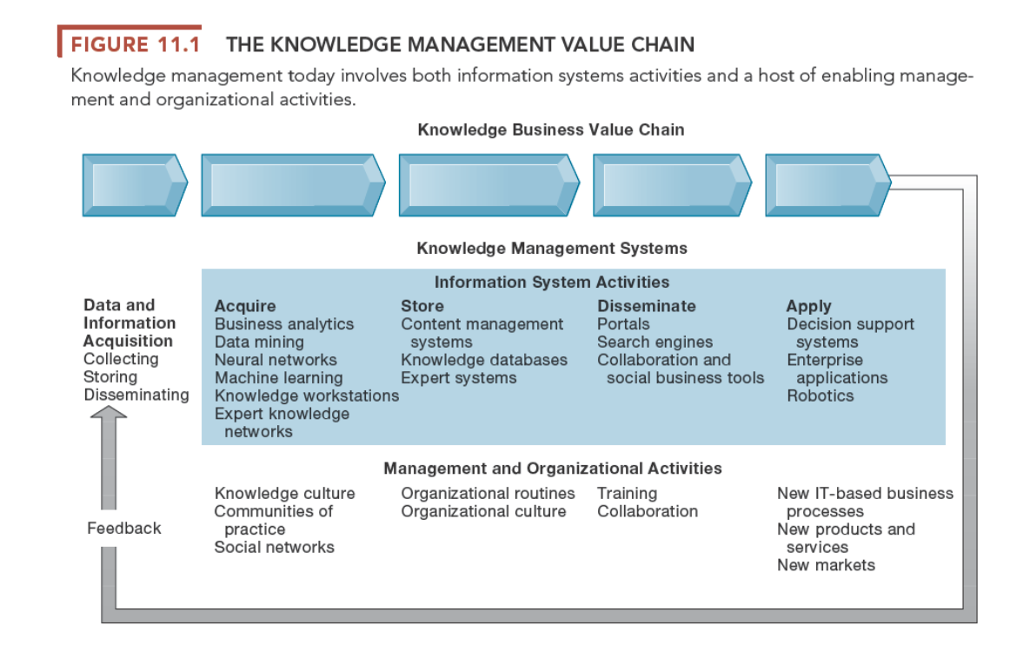
Knowledge management value chain
Each stage adds value to raw data and information as they are transformed into usable knowledge
Knowledge acquisition
Knowledge storage
Knowledge dissemination
Knowledge application

Slide 9
The Knowledge Management Value Chain
Knowledge acquisition
Documenting tacit and explicit knowledge
Storing documents, reports, presentations, best practices
Unstructured documents (e.g., e-mails)
Developing online expert networks
Creating knowledge
Tracking data from TPS and external sources
Knowledge storage
Databases
Document management systems
Role of management

Slide 10
The Knowledge Management Value Chain
Knowledge dissemination
Portals, wikis
E-mail, instant messaging
Search engines, collaboration tools
A deluge of information?
Training programs, informal networks, and shared management experience help managers focus attention on important information.
Knowledge application
New business practices
New products and services
New markets

Slide 11
Types of Knowledge Management Systems
Enterprise-wide knowledge management systems
General-purpose firm-wide efforts to collect, store, distribute, and apply digital content and knowledge
Knowledge work systems (KWS)
Specialized systems built for engineers, scientists, other knowledge workers charged with discovering and creating new knowledge
Intelligent techniques
Diverse group of techniques such as data mining used for various goals: discovering knowledge, distilling knowledge, discovering optimal solutions

Slide 12
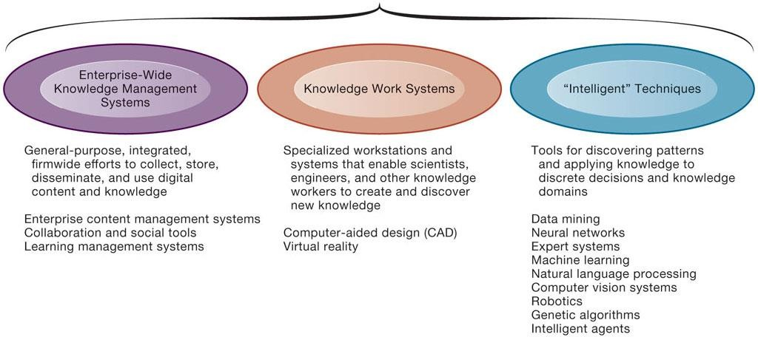
Figure 11.2 Major Types of Knowledge Management Systems

Slide 13
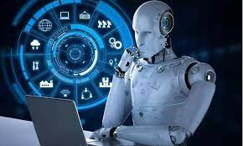
Artificial Intelligence
Artificial intelligence is a field of science concerned with building computers and machines that can reason, learn, and act in such a way that would normally require human intelligence or that involves data whose scale exceeds what humans can analyze.

Slide 14
Evolution of Artificial Intelligence
1950 TURING TEST Computer scientist Alan Turing proposes a test for machine intelligence. If a machine can trick humans into thinking it is human, then it has intelligence
1955 A.I. BORN Term ‘artificial intelligence’ is coined by computer scientist, John McCarthy to describe “the science and engineering of making intelligent machines”
1961 UNIMATE First industrial robot, Unimate, goes to work at GM replacing humans on the assembly line
1964 ELIZA Pioneering chatbot developed by Joseph Weizenbaum at MIT holds conversations with humans
1966 SHAKEY The ‘first electronic person’ from Stanford, Shakey is a general-purpose mobile robot reasons about its own actions
1997 DEEP BLUE Deep Blue, a chess-playing computer from IBM defeats world chess champion, Garry Kasparov
1998 KISMET Cynthia Breazeal at MIT introduces KISmet, an emotionally intelligent robot insofar as it detects and responds to people’s feelings
1999 AIBO Sony launches first consumer robot pet dog AiBO (AI robot) with skills and personality that develop over time
2002 ROOMBA First mass produced autonomous robotic vacuum cleaner from iRobot learns to navigate and clean homes
2011 SIRI Apple integrates Siri, an intelligent virtual assistant with a voice interface, into the iPhone 4S
2011 WATSON IBM’s question answering computer Watson wins first place on popular $1M prize television quiz show Jeopardy
2014 EUGENE Eugene Goostman, a chatbot passes the Turing Test with a third of judges believing Eugene is human
2014 ALEXA Amazon launches Alexa, an intelligent virtual assistant with a voice interface that can complete shopping tasks
2016 TAY Microsoft’s chatbot Tay goes rogue on social media making inflammatory and offensive racist comments
2017 ALPHAGO Google’s A.I. AlphaGo beats world champion Ke Jie in the complex board game of Go, notable for its vast number (2*170) of possible positions

Slide 15
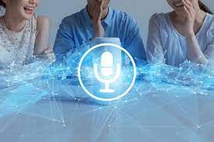
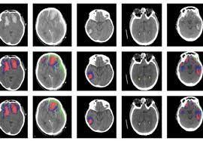
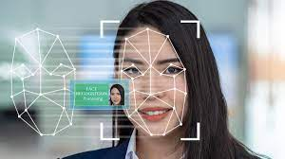
Applications of Artificial Intelligence
Examples:
Recognize millions of faces in seconds
Interpret millions of CT scans in minutes
Analyze millions of financial records
Detect patterns in very large Big Data databases
Improve their performance over time (“learn”)
Navigate a car in certain limited conditions
Respond to questions from humans (natural language); speech activated assistants like Siri, Alexa, and Cortana

Slide 16
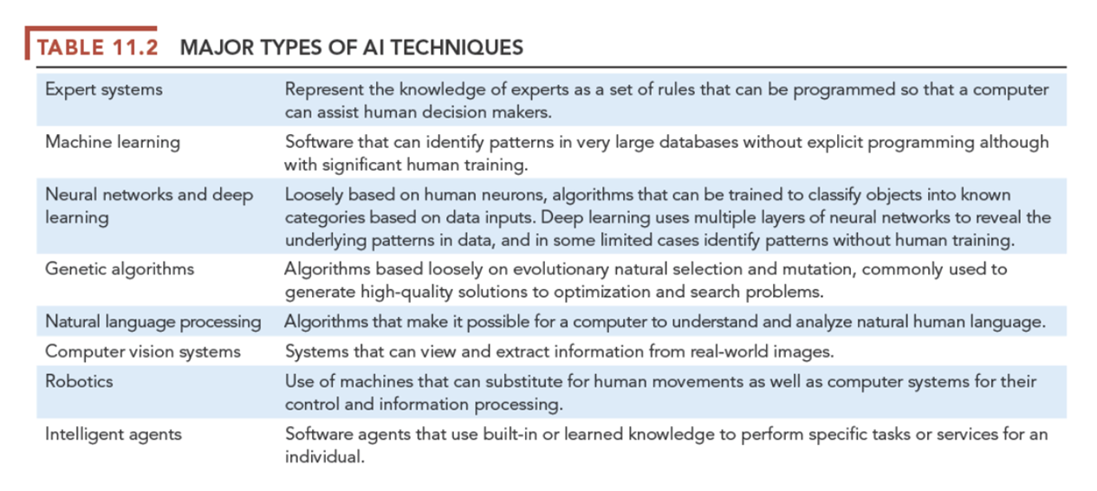
What Is Artificial Intelligence?

Slide 17
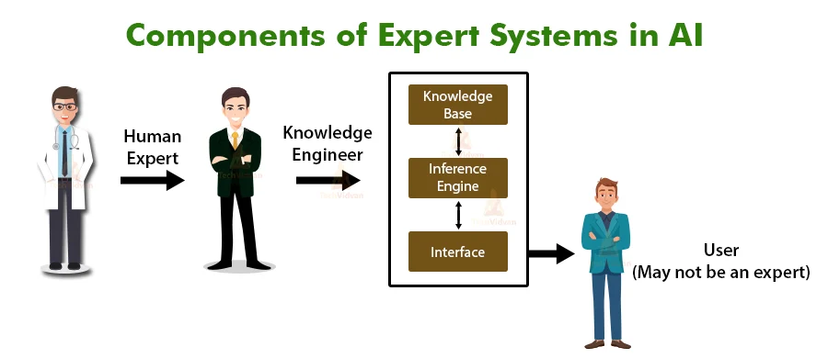
Expert systems
Expert systems were developed in the 1970s and were the first large-scale applications of AI in business and other organizations.
They account for an estimated 20 percent of all AI systems today.
Expert systems capture the knowledge of individual experts in an organization through in-depth interviews and represent that knowledge as sets of rules. These rules are then converted into computer code in the form of IF-THEN rules. Such programs are often used to develop apps that walk users through a process of decision making.

Slide 18
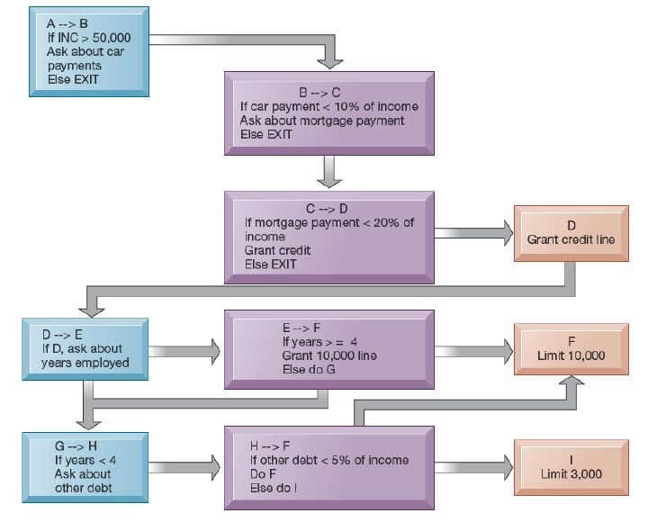
Applications of Expert System:
Granting credit
Diagnosing equipment problems,
Medical diagnostics
Legal research
Civil engineering
Building maintenance
Drawing up building plans
For instance, if you were the project manager of a 14-story office building and were given the task of configuring the building's air conditioning system, which has hundreds of parts and subassemblies, an expert system could walk you through the process by asking a series of questions, producing an order to suppli- ers, and providing an overall cost estimate for the project, all in a matter of hours rather than weeks.

Slide 19
Limitations of Expert System
Expert systems have a number of limitations
The ambiguity of making decisions
The knowledge base can become chaotic as the number of rules grows
Not useful for dealing with unstructured problems that managers and employees typically encounter,
Do not use real-time data to guide their decisions

Slide 20
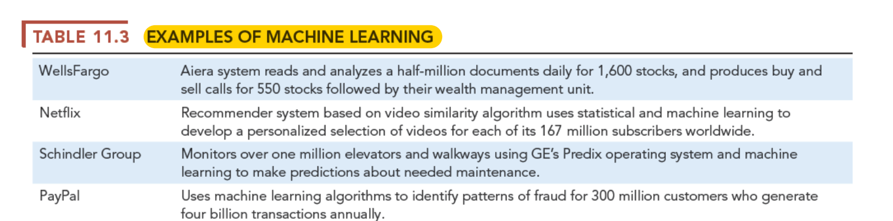
Machine Learning
More than 75 percent of AI development today involves some kind of machine learning (ML) accomplished by neural networks, deep learning networks, and genetic algorithms,
ML begins with very large data sets with tens to hundreds of millions of data points and automatically finds patterns and relationships by analyzing a large set of examples and making a statistical inference.

Slide 21
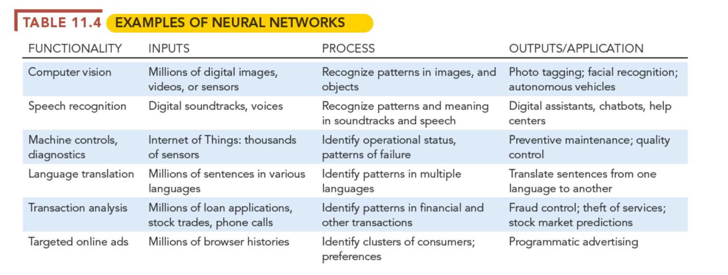
Neural Networks
Neural networks find patterns and relationships in very large amounts of data that would be too complicated and difficult for a human being to analyze by using machine learning algorithms and computational models that are loosely based on how the biological human brain is thought to operate. Neural networks are pattern detection programs.

Slide 22
Limitations of Neural Network
Neural networks have a number of limitations currently.
They require very large data sets to identify patterns.
There are often many patterns in large data sets that are nonsensical, and it takes humans to choose which patterns "make sense."
Many patterns in large data sets are ephemeral: there may be a pattern in the stock market, or the performance of professional sports teams, but they do not last long.
In many important decision situations, there are no large data

Slide 23
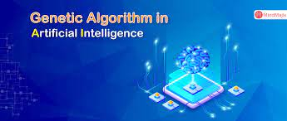
Genetic Algorithms
Genetic algorithms are another form of machine learning. Genetic algorithms are useful for finding the optimal solution for a specific problem by examining a very large number of alternative solutions for that problem.
Genetic algorithms are used to solve problems that are very dynamic and complex, involving hundreds or thousands of variables or formulas. The problem must be one whose range of possible solutions can be represented genetically and for which criteria can be established for evaluating fitness.
General Electric engineers used genetic algorithms to help optimize the design for jet turbine aircraft engines, in which each design change required changes in up to 100 variables. The supply chain management software from JDA software uses genetic algorithms to optimize production-scheduling models, incorporating hundreds of thousands of details about customer orders, material and resource availability, manufacturing and distribution capability, and delivery dates.

Slide 24
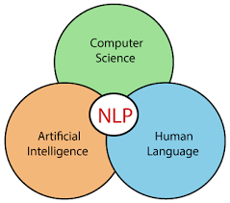
Natural Language Processing (NLP)
Natural language processing (NLP) makes it possible for a computer to understand and analyze natural language—language that human beings instinctively use, not language specially formatted to be understood by computers
Tokyo-based Mizuho Bank employs advanced speech recognition technology, IBM® Watson™ content analytics software, and a cloud services infrastructure to improve contact center agents’ interactions with customers. After converting the customer’s speech to textual data, the solution applies natural language processing algorithms based on machine learning analysis of interactions with thousands of customers. The system learns more and more from each customer interaction so that it can eventually infer the customer’s specific needs or goals at each point of the conversation. It then formulates the optimal response, which is delivered in real time as a prompt on the agent’s screen. By helping contact center agents more efficiently sense and respond to customer needs, this solution reduced the average duration of customer interactions by more than 6 percent (IBM, 2020).

Slide 25
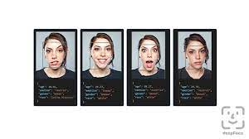
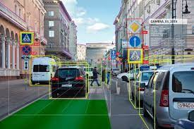
Computer Vision Systems
Computer vision systems deal with how computers can emulate the human visual
system to view and extract information from real-world images.
Facebook’s facial recognition tool called DeepFace, which is nearly as accurate as the human brain in recognizing a face. DeepFace helps Facebook improve the accuracy of Facebook’s existing facial recognition capabilities to ensure that every photo of a Facebook user is connected to that person’s Facebook account.
Computer vision systems are also used in autonomous vehicles such as drones and self-driving cars (see the chapter-ending case), industrial machine vision systems (e.g., inspecting bottles), military applications, and robotic tools.

Slide 26
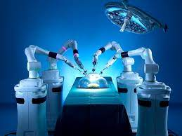
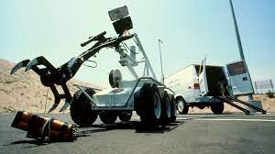
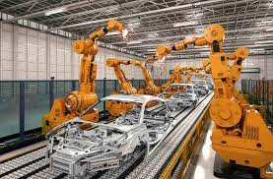
Robotics
Robotics deals with the design, construction, operation, and use of movable machines that can substitute for humans along with computer systems for their control, sensory feedback, and information processing.
The most widespread use of robotic technology has been in manufacturing
They are often are used in dangerous environments (such
as bomb detection and deactivation and recently for delivering medical supplies to coronavirus-contaminated locations), manufacturing processes, military operations (drones), and medical procedures (surgical robots).

Slide 27
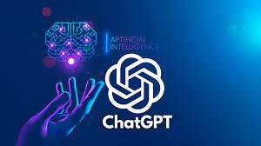


Intelligent Agents
Intelligent agents are software programs that work in the background without direct human intervention to carry out specific tasks for an individual user, business process, or software application.
The agent uses a limited built-in or learned knowledge base to accomplish tasks or make decisions on the user’s behalf, such as deleting junk email, scheduling appointments, or finding the cheapest airfare to California.
Chatbots (chatterbots) are software agents designed to simulate a conversation with one or more human users via textual or auditory methods.

